Slide 1
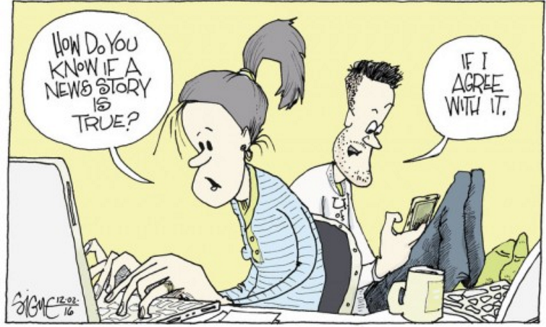
Flagging Fake News
GROUP 06
7 April 2017
Deivapriya RAJENDIRAN | A0160989L
KOH Jia Xiang | A0161060X
LIAW Sze Wai Sylvia | A0161065M
NG Hui Yi Nicole | A0116105X
XU Yuwen | A0161003A
YAU Chung Yin Jack | A0160936B

Slide 2
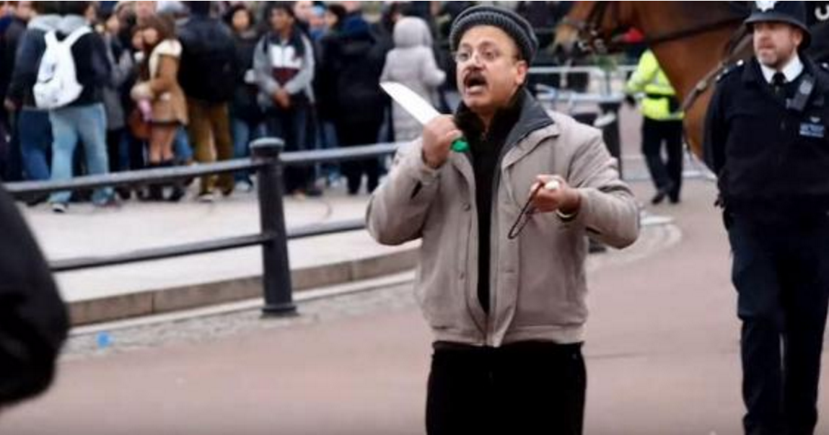
22 Mar 2017 London Attacker
4 people dead (including the assailant)
& at least 40 injured
FAKE
2013: A man outside of Buckingham Palace holding a knife to his neck.
Notes:
Reported in Russia.

Slide 3
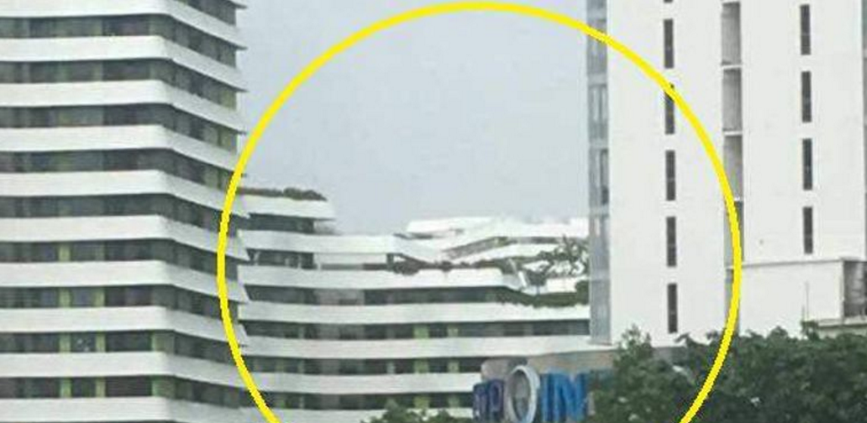
While in Singapore….
Rooftop of Punggol Waterway Terraces had collapsed
FAKE
In Nov 2016, All Singapore Stuff falsely claimed that the rooftop of Punggol Waterway Terraces had collapsed. SPF & SCDF had to investigate → "Taxpayers pay the cost for all this."

Slide 4
Definition
Fake news
deliberately published false stories, misinformation, and propaganda purported by websites to be real news
~5 types
Intentionally deceptive
Jokes taken at face value
Large-scale hoaxes
Slanted reporting of real facts
Stories where the ‘truth’ is contentious
Not to be mistaken from satirical publications (purpose is to humour), e.g. The Onion and ClickHole
However, some use satire to talk about current events. If people don't understand that, they might share these articles after reading them in the literal sense
Use website spoofing to imitate online news media websites like ABC news → adopt the same design, or a similar URL as the target website

Slide 5

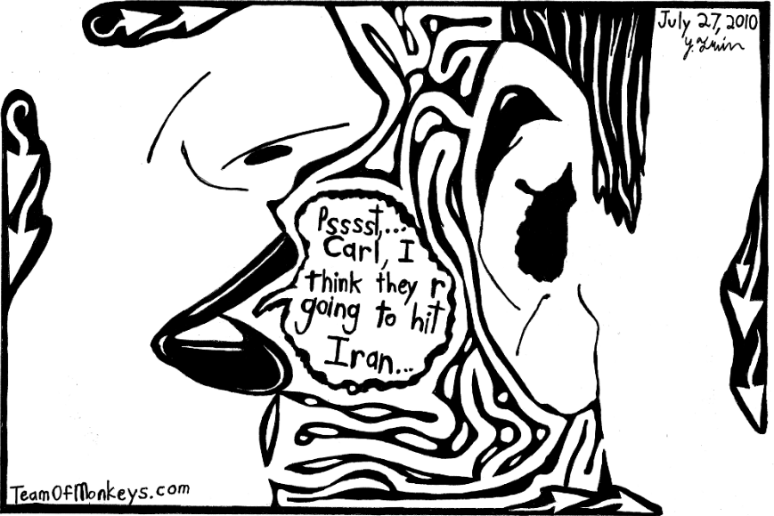

Communication Mode
Ref: Dreamstime.com

Slide 6
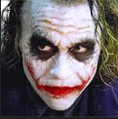
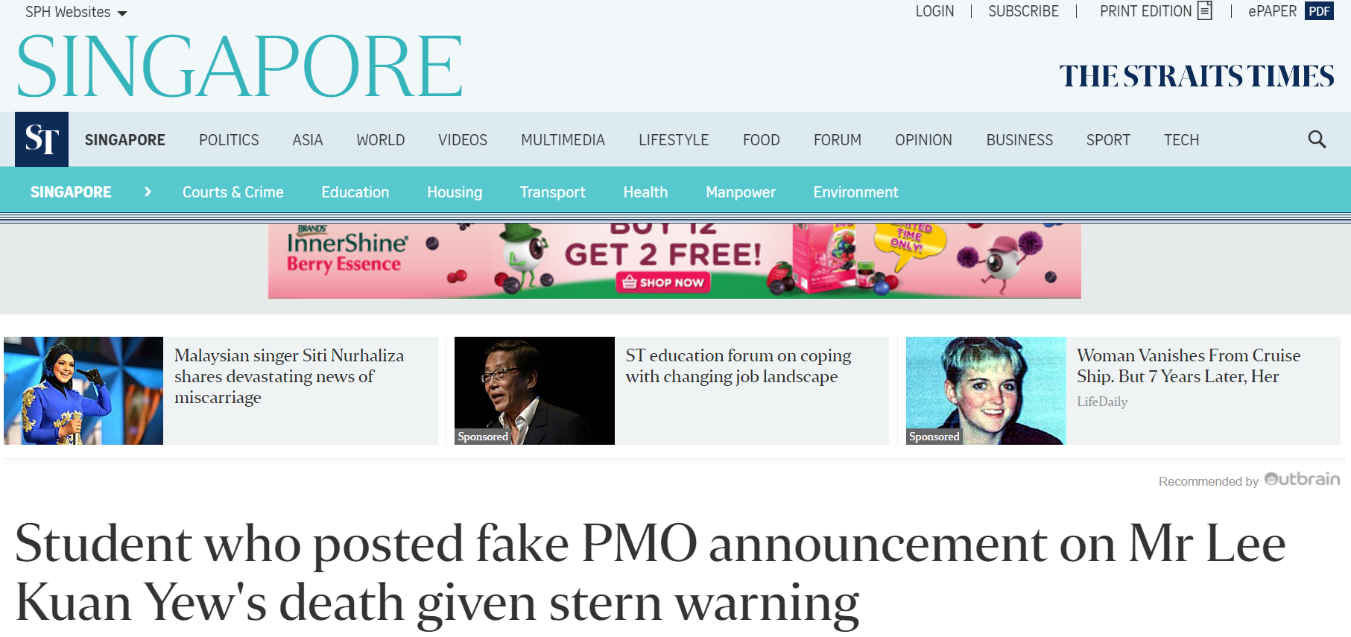
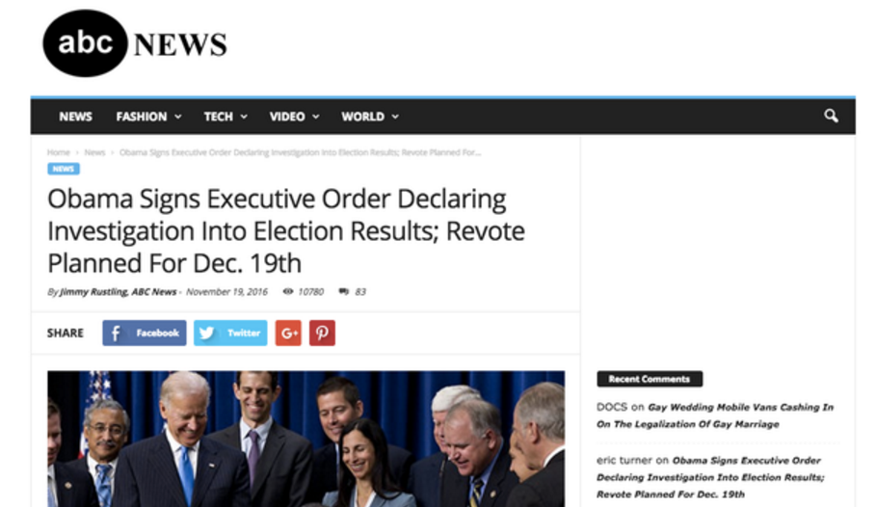
Why so serious?!
http://fakenewswatch.com/
Notes:
fake news can be used as a powerful tool to interfere with domestic affairs and politics; it can even swing elections.
For example, before the Brexit referendum, there were misleading stories fuelling xenophobia and anti-immigrants sentiments

Slide 7
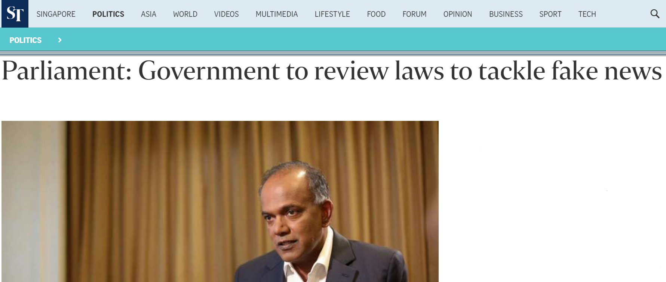
SG Govt to Tackle Fake News
Mr Shanmugam said a review is needed as fake news can have real consequences: "They can cause harm to innocent Singaporeans; they can cause unnecessary alarm to the public; emergency resources may be diverted from legitimate emergencies and the reputation of honest Singapore businesses may be unfairly damaged."
Fake News Websites in SG:
The Real Singapore
States Times Review
All Singapore Stuff
Date: 3 Apr 2017
http://www.straitstimes.com/politics/parliament-government-to-review-laws-to-tackle-fake-news

Slide 8
Business Motivations
Take advantage of social media to drive traffic → ↑ advertising revenue
Affect outcomes → e.g. Fake news has influenced the political discourse of multiple countries
Damage the trustworthiness → e.g. Pepsi’s sentiment score dipped and share price dropped significantly due to a single piece of fake news
Failure to identify and remove fake news → may find themselves under investigation and fined
Readers of fake news suffer from time and monetary loss!
Objectives of study:
Identifying the common characteristics of fake news;
Detecting the authenticity of news; &
Generating business insights from the common characteristics of fake news
Notes:
People may use fake news to destabilise society, or not caring if it destabilises society so long as they make money.
Several countries have called for a tough stance against fake news. Germany, for example, is considering a draft law which will require social networks like Facebook to remove fake news amounting to illegal content from their platforms, or risk fines of up to 50 million euros.
The United Kingdom is launching a parliamentary probe into fake news, calling it a "threat to democracy", he noted.

Slide 9
Some Known Characteristics
Combat spam websites using Link analysis (e.g. PageRank & TrustRank). However, still have their limitations e.g. the use of spam farms
Headlines of news
Exploit readers’ emotions (with sensational headlines) → ripple effect
First few paragraphs need to sound legitimate → Content analysis of the text

Slide 10
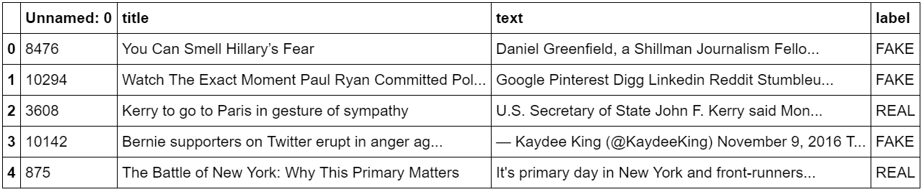
Methodology
Data – https://github.com/GeorgeMcIntire/fake_real_news_dataset
6,335 articles (headlines & text)
Remove stop-words, punctuations, empty text, etc
Except for “!” & “?”
Fake (3,128) & Real (3,171) news

Slide 11
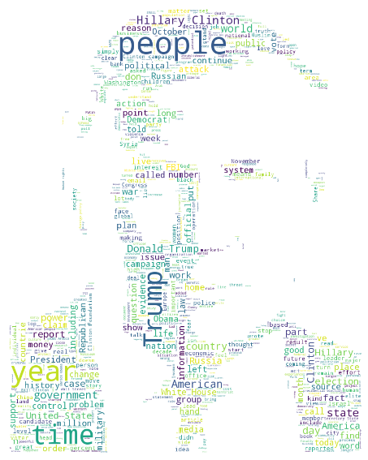
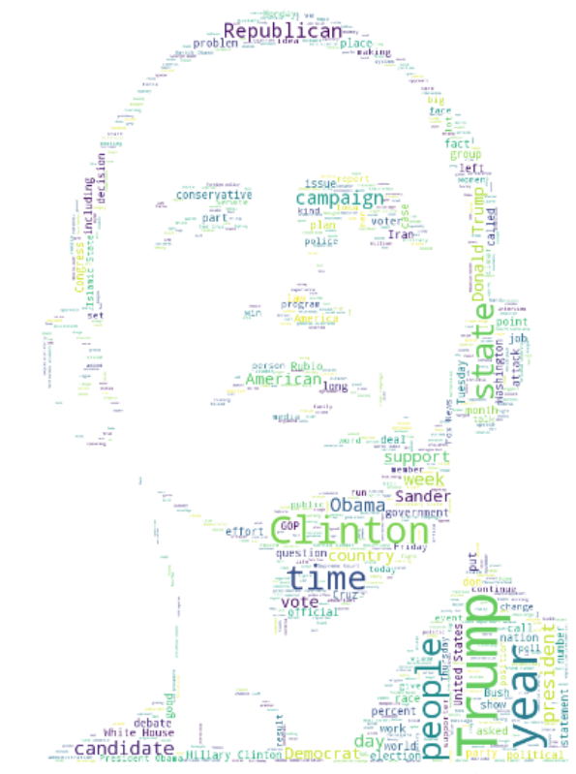
Data Exploration
vs

Slide 12
Analysis
Model comparisons
Null accuracy = 50.7%
First round of modeling with different permutations of CountVectorizer (~90% accuracy & AUC)

Slide 13
Analysis – More Feature Engineering (x64)
General | Sentiment Analysis | LDA | Stance Detection
# of words in news articles Readability index # of CAP words # of exclamation marks # of question marks | Polarity of headlines & text Subjectivity of headlines & text AFINN scores of headlines & text | Use elbow method for optimal k (i.e. 4) Topic probabilities | Stance Detection involves estimating the relative perspective (or stance) of two pieces of text relative to a topic, claim or issue. Headline vs Text

Slide 14
Stance Detection Example
Headline
“Robert Plant Ripped up $800M Led Zeppelin Reunion Contract”
Snippets from Text
“… Led Zeppelin’s Robert Plant turned down £500 Millions to reform supergroup….” [agree]
“… No, Robert Plant did not rip up $800 million deal to get Led Zeppelin back together…” [disagree]
“… Robert Plant reportedly tore up an $800 million Led Zeppelin reunion deal…” [discusses]
‘…Richard Branson’s Virgin Galactic is set to launch SpaceShip Two today…” [unrelated]
Ref: http://www.fakenewschallenge.org/

Slide 15
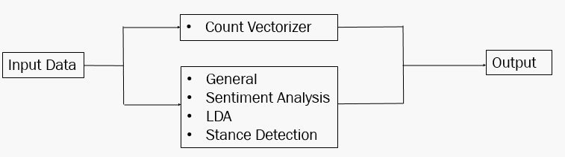
Analysis – 2nd round of modeling
Ensemble modeling
Logistic regression, gradient boosting and neural network models from first round
Incorporated into pipelines
Parameters were tuned further
Build an ensemble model
Model | Accuracy | AUC
Null Model | 50.7% | -
Log Regression | 92.8% | 97.2%
GBM | 91.2% | 97.3%
Neutral Network | 93.1% | 97.6%
Ensemble | 93.0% | 98.0%

Slide 16
Count Vectorizer
Input Data
Output
General
Sentiment Analysis
LDA
Stance Detection

Slide 17
Results
Lists of Models
CountVectorizer
CountVectorizer with 1-grams and 2-grams
CountVectorizer with 1-grams and 2-grams, and only keep terms that appear in at least 2 documents
CountVectorizer and ignore terms that appear in >50% of the documents
CountVectorizer and only keep the top 1000 most frequent terms
Model comparisons
Null accuracy = 50.7%
Model | Accuracy | AUC
Naïve Bayes | 88.3% | 93.5%
Log Regression | 90.9% | 96.3%
Tree | 81.5% | 81.4%
Random Forest | 83.8% | 92.4%
GBM | 89.5% | 96.8%
SVM | 74.9% | 89.6%
Neutral Network | 91.3% | 96.0%

Slide 18
Results
Length
Subjectivity (text)
Fog_index
Afinn (headline & text)
T0 – T3 (LDA)
# cap words
#exclamations
Presence of refuting words in headline
Refute word ‘deny’
Presence of refuting words in text
number of overlap words between headline and text
2 chargram for first 255 words in text
8 chargram for entire text
6 ngrams for entire text

Slide 19
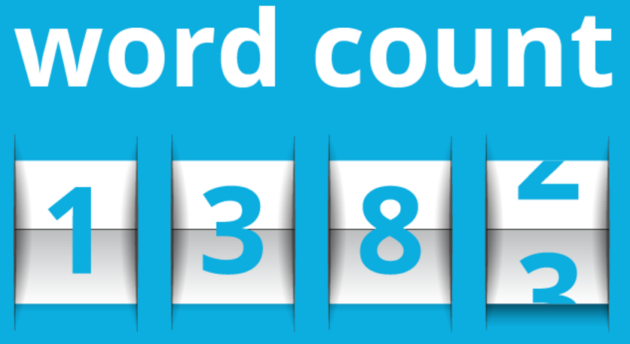
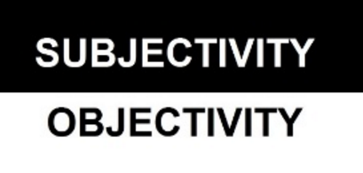






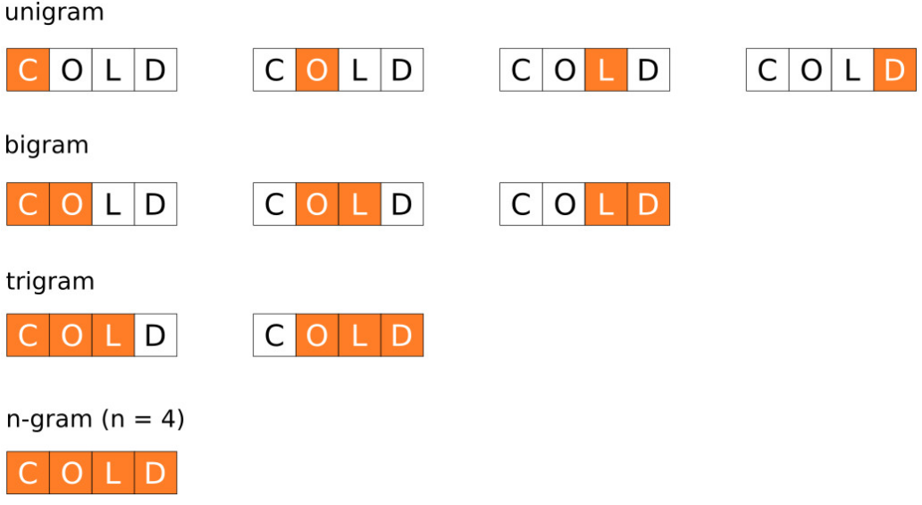
How to Spot Fake News? – Significant Predictors
Length of news
Subjectivity of news
Readability
Sentiment
# CAP words
# exclamation
Refute words in headlines & text
# overlap words in headlines & text
6 ngrams in entire text

Slide 20


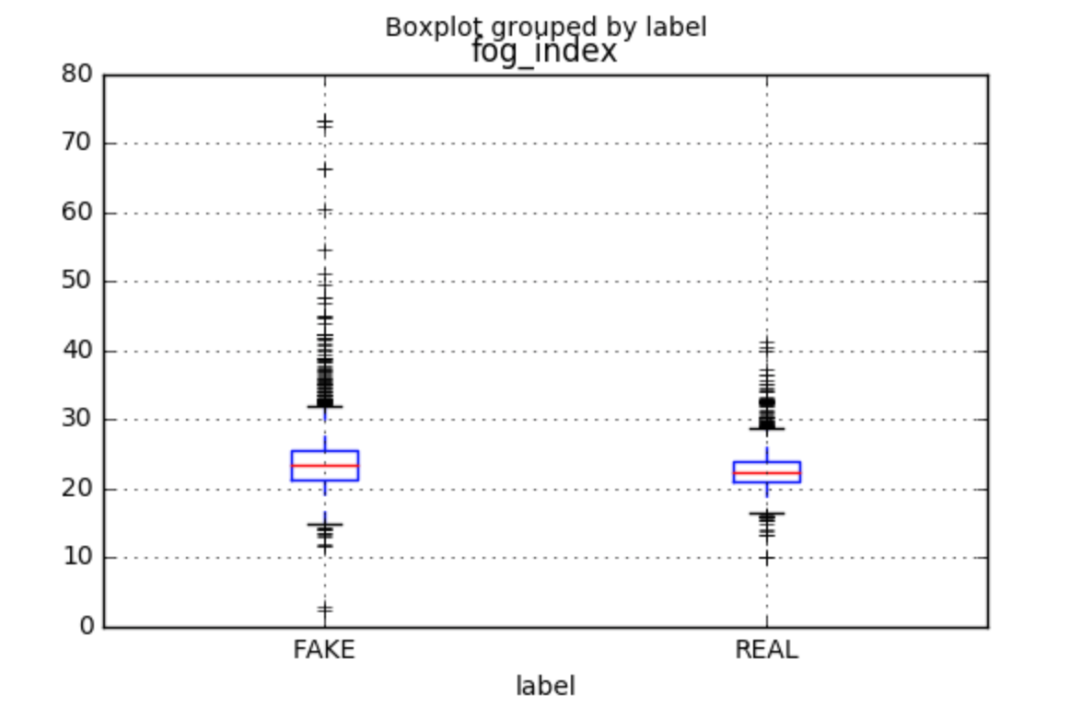
General Features
READ ME!!
NUMBER OF CAP WORDS AND EXCLAMATION
AVERAGE LENGTH OF THE DOCUMENT
READABILITY OF THE TEXT
FAKE | REAL
4168 | 5292
CAP Words | Mean | Max
FAKE | 6.7 | 180
REAL | 4.8 | 128
! Count | Mean | Max
FAKE | 0.80 | 104
REAL | 0.26 | 14

Slide 21
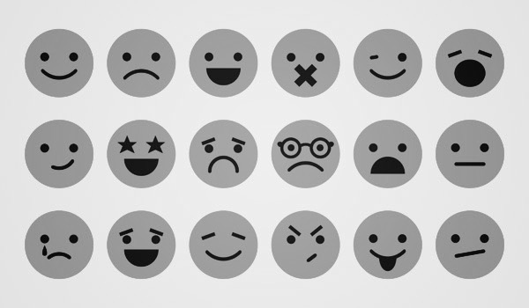
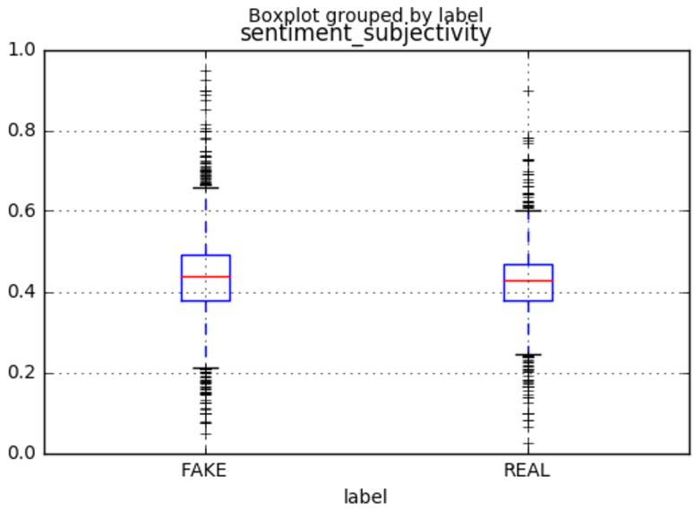
Sentiment Analysis
AFINN SCORE OF TEXT AND TITLE
SUBJECTIVITY OF TEXT
Mean Afinn score | TEXT | TITLE
FAKE | -8.2 | -0.6
REAL | 1.3 | -0.3

Slide 22
LDA Topics
REAL
FAKE
FAKE
REAL
Topic 0 | Topic 1 | Topic 2 | Topic 3
Trump | People | State | Police
Clinton | World | Clinton | Obama
Campaign | - | War | Law
Party | Time | Russia | Court
Republican | Years | Military | House
Hillary | Year | FBI | President
President | ! | Obama | People
Election | Government | President | Congress
Sanders | Percent | People | State
Donald | System | Iran | Federal

Slide 23
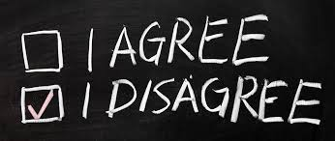
Stance Detection
Stance detection helps understand if the author is in favor of, against or neutral towards the title or proposition
Stance of the text might give more insight into the authenticity of the news
 | 1 | 2 | 3 | 4 | 5 | 6
Presence of refuting words in text and title
Overlap of words between text and title
6 ngrams for entire text

Slide 24
Testing on External Data
Downloaded extra data for further testing
Headline | Text (first 2 sentences as e.g.) | Label | Predict
The United States Revokes Scientology’s Tax-Exempt Status | In a unanimous decision by the Supreme Court today, the eight justices ruled in favor of revoking the Church of Scientology’s tax-exempt status in the United States. | Fake
President Trump To Move White House to Las Vegas | Donald Trump has made plans to officially move the White House from Washington, D.C. to Las Vegas, where he owns property and says that the taxes are “much more manageable.” “Moving the White House to Las Vegas will save tax payers an estimated $20 million a year, as the land values are much lower in the desert,” said Trump. “I am working with the best planners, the best men out there, to move the White House safely and securely.” | Fake
Trump is erasing the red line in Syria and drawing a hard line on North Korea | Washington (CNN)In one 24-hour period, President Donald Trump's administration erased a red line in Syria and drew a new hard line in North Korea. Here's a simpler way to look at what we learned about the new President's foreign policy Tuesday: unenforced red lines in Syria and former President Barack Obama's "weakness" helped cause a chemical weapons attack are bad and no longer operable. | Real

Slide 25
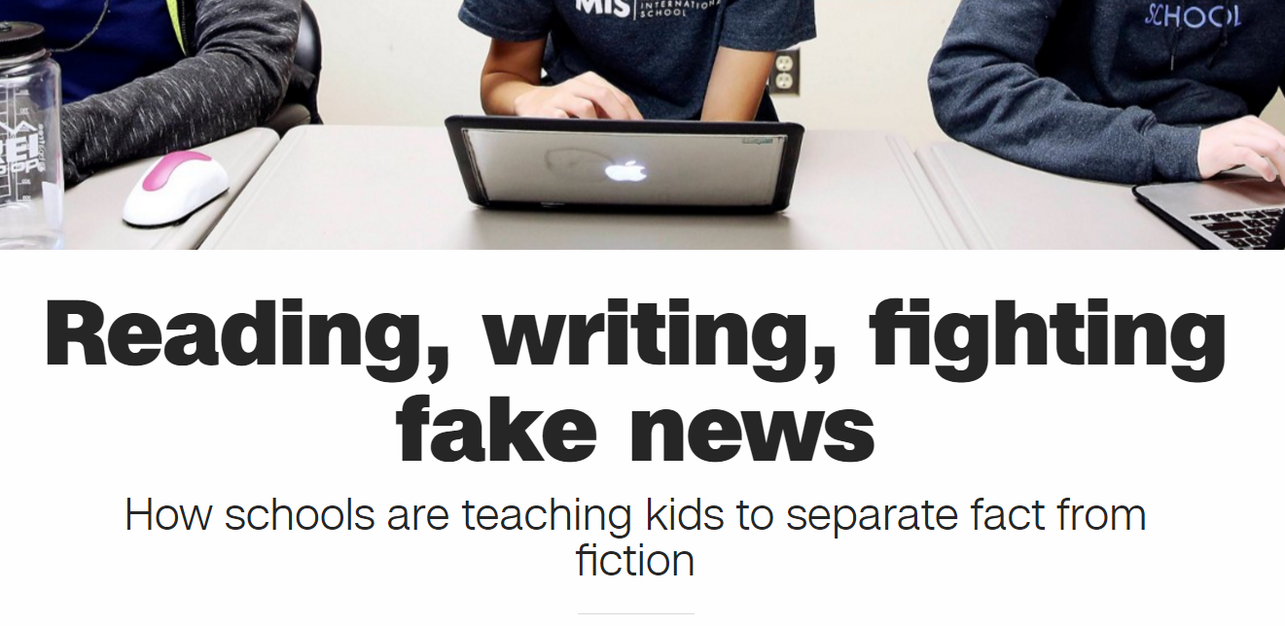
Conclusion
Direct use by media to filter out fake news
Education & raise awareness
http://edition.cnn.com/2017/03/29/health/school-kids-fight-fake-news-trnd/
Continuous machine learning process to combat new features and to keep up with adaptive behavior of fake news writers
Notes:
Twitter, fb, other social medias, news channels, etc can screen the authenticity of the news with the predictors. Minimize the spread of wrong information.
However, writers are also adapting, hence it is hard to catch up.

Slide 26
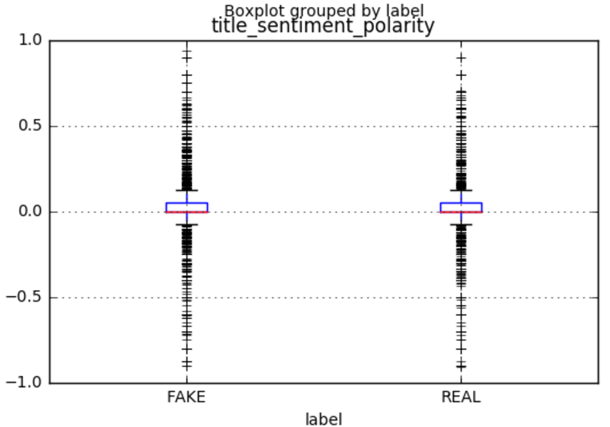
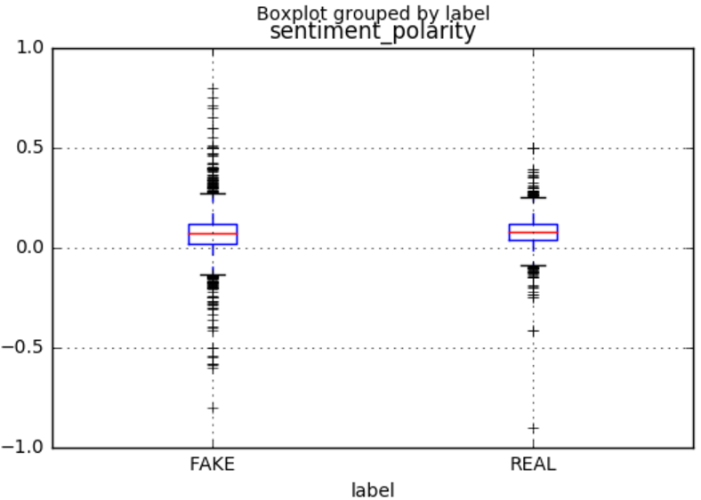
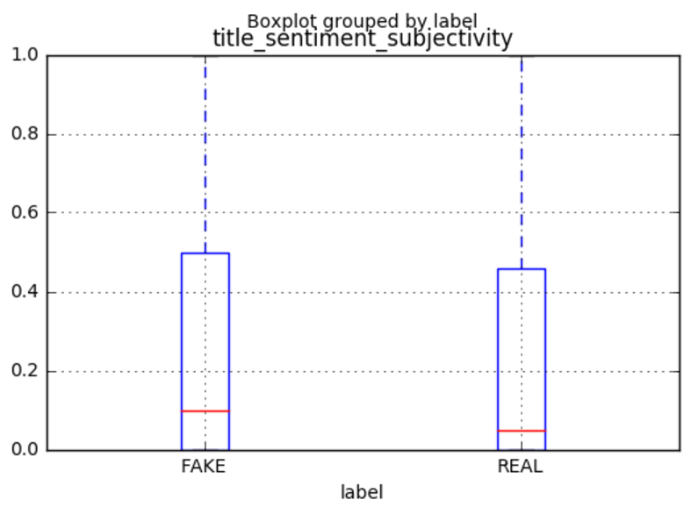
Sentiment Polarity & Subjectivity of Headlines & Text

Slide 27
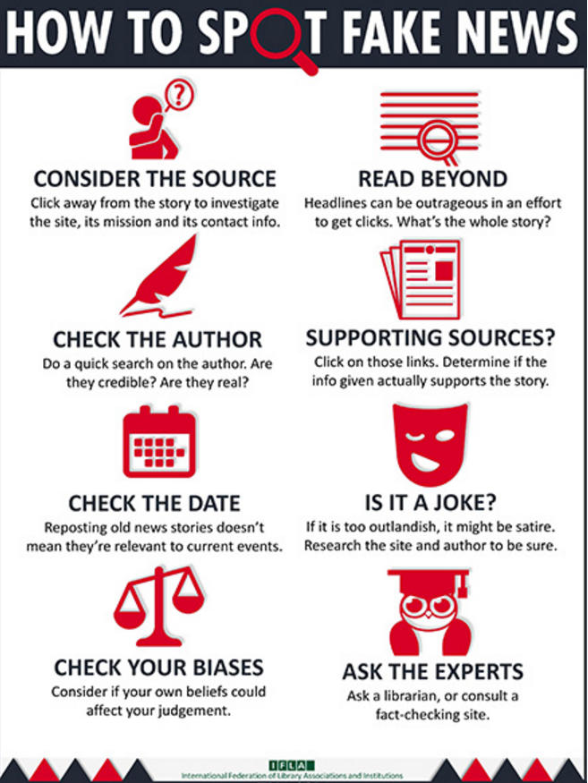
Results – Predictors???
Example of infographic
Pending
Infographics style

Slide 28
Selected References
Davis, W. (2016, Dec 5). Fake or Real? How to Self-Check the News and Get the Facts. npr. Retrieved from http://www.npr.org/sections/alltechconsidered/2016/12/05/503581220/fake-or-real-how-to-self-check-the-news-and-get-the-facts
Gupta, S. (2016, Dec 6). Trump supporters call to boycott Pepsi over comments the CEO never made. CNN. Retrieved from http://money.cnn.com/2016/11/16/news/companies/pepsi-fake-news-boycott-trump/
Mikelionis, L. (2016, Dec 27). Germany considers fining facebook $522,000 per fake news item. Heatstreet. Retrieved from https://heatst.com/tech/germany-considers-fining-facebook-522000-per-fake-news-item/
Silverman, C. (2016, Nov 17). This analysis shows how viral fake election news stories outperformed real news on facebook. BuzzFeed News. Retrieved from https://www.buzzfeed.com/craigsilverman/viral-fake-election-news-outperformed-real-news-on-facebook?utm_term=.gxOJamP1#.vywwDpQg
Vinci shares plunge on publication of fake press release. (2016, Nov 22). Retrieved from http://www.bbc.com/news/business-38071474
Willingham, E. (2016, Nov 28). A scientific approach to distinguishing real from fake news. Forbes. Retrieved from http://www.forbes.com/sites/emilywillingham/2016/11/28/a-scientific-approach-to-distinguishing-real-from-fake-news/#3abb43142692

